Slide 1


PIZZA SALES REPORT
SQL QUERIES

Slide 2
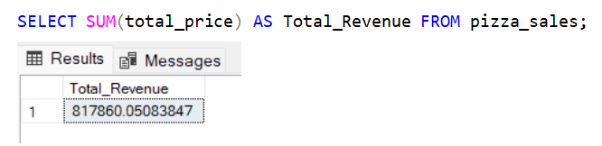
KPI’s
1. Total Revenue:

Slide 3
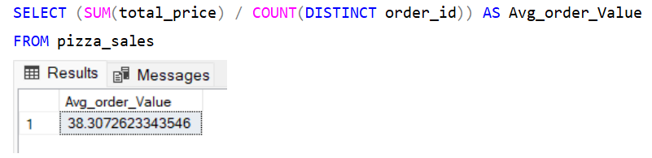
2. AVG ORDER VALUE:

Slide 4
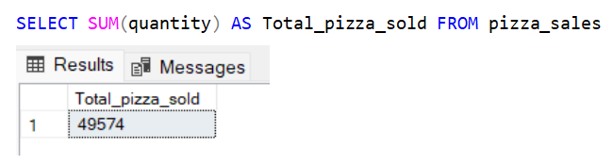
3. TOTAL PIZZA’S SOLD:

Slide 5
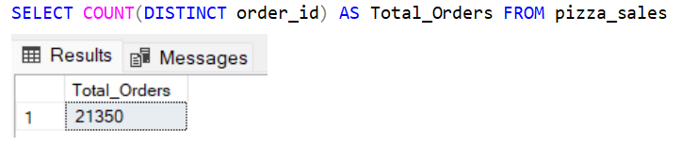
4. TOTAL ORDERS:

Slide 6
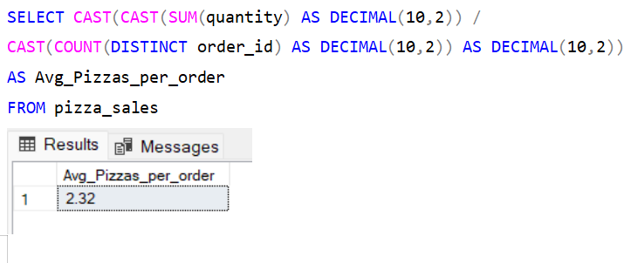
5. AVG PIZZA’S SOLD:

Slide 7
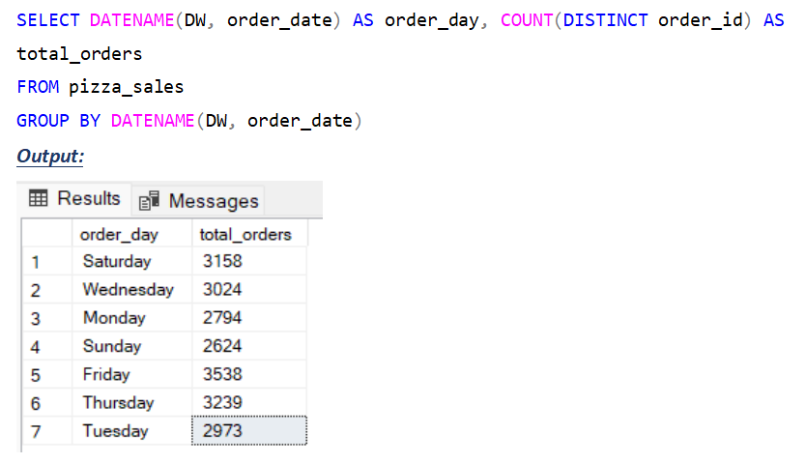
B. Daily Trend for Total Orders

Slide 8
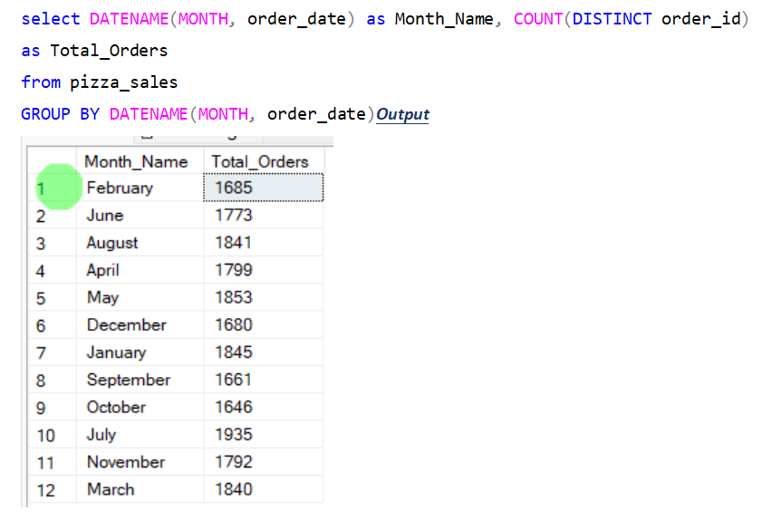
C. Monthly Trend for Orders

Slide 9
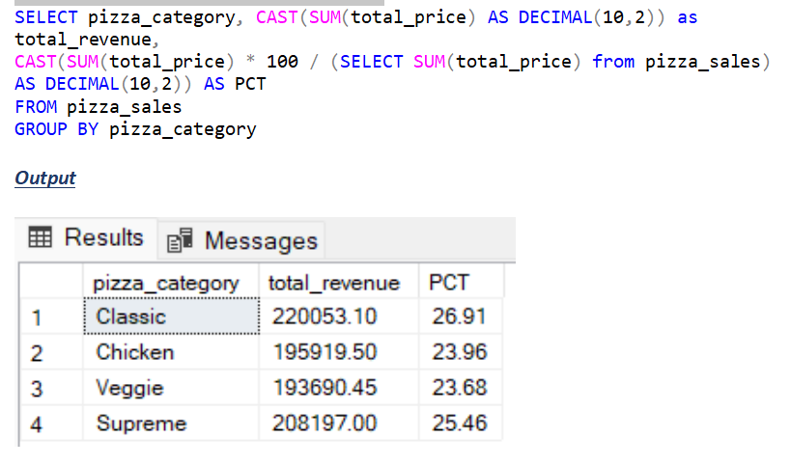
D. % of Sales by Pizza Category

Slide 10
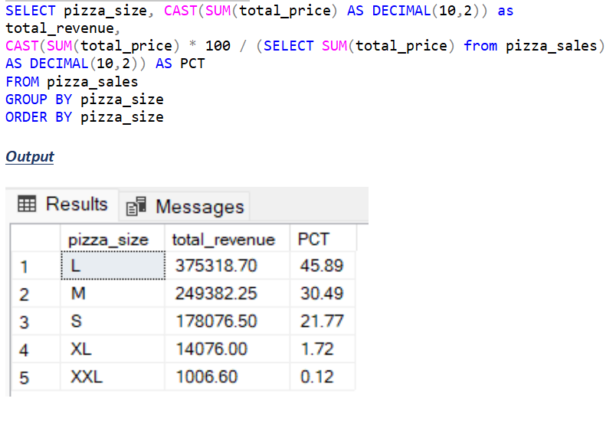
E. % of Sales by Pizza Size

Slide 11
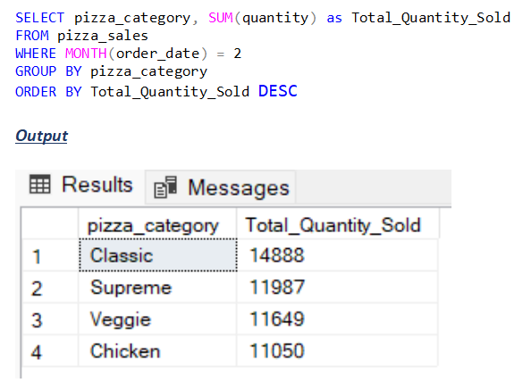
F. Total Pizzas Sold by Pizza Category

Slide 12
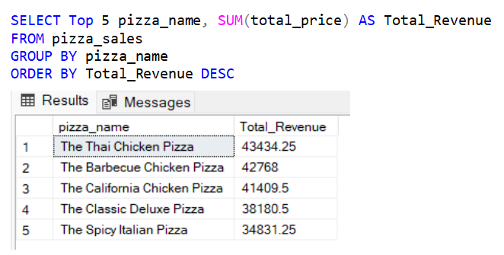
G. Top 5 Pizzas by Revenue

Slide 13
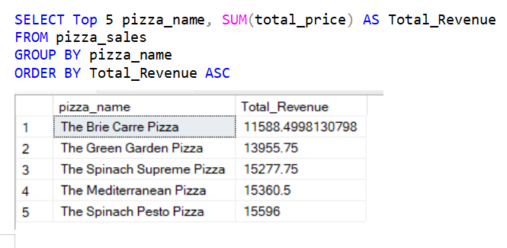
H. Bottom 5 Pizzas by Revenue

Slide 14
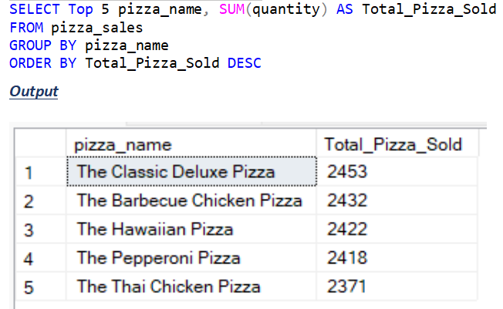
I. Top 5 Pizzas by Quantity

Slide 15
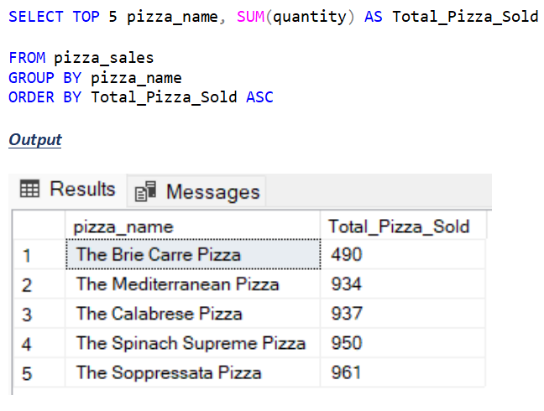
J. Bottom 5 Pizzas by Quantity

Slide 16
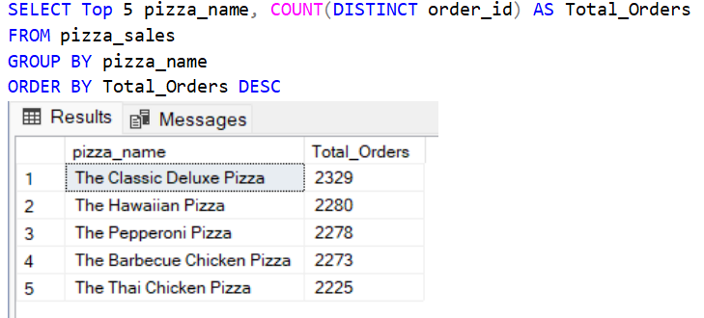
K. Top 5 Pizzas by Total Orders

Slide 17
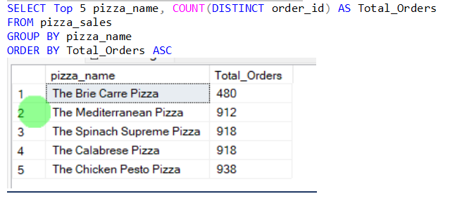
L. BoTTom 5 Pizzas by Total Orders

Slide 18
THANK YOU

